Slide 1

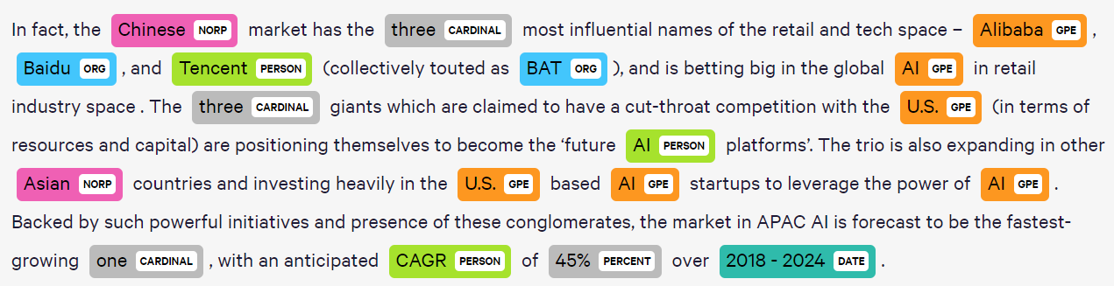
Customer NER Models
Named entity recognition (NER) uses a specific annotation scheme, which is defined (at least for European languages) at the word level. An annotation scheme that is widely used is called IOB-tagging, which stands for Inside-Outside-Beginning. Each tag indicates whether the corresponding word is inside, outside or at the beginning of a specific named entity. The reason this is used is because named entities usually comprise more than 1 word.

Slide 2
Agenda
Spacy
Custom NER model using Spacy
Data Preparation for Spacy NER model
Performance of Spacy NER Model
Transformers/ BERT
Custom NER model using Transformers (Deep Learning)
Data Preparation for Transformers NER model
Performance of Transformers NER Model
Comparison of Spacy and BERT NER models
Conclusion

Slide 3
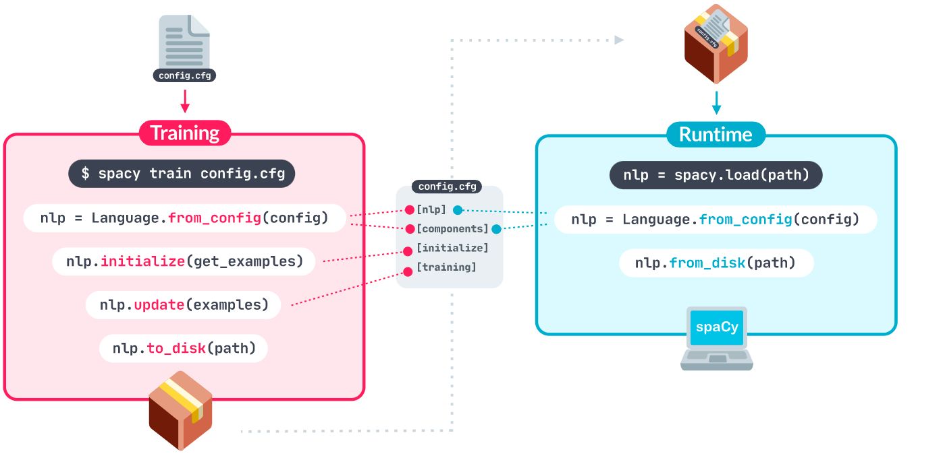
Custom NER model using Spacy
The Overall Process is

Slide 4
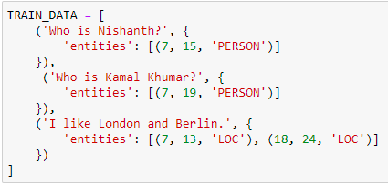
Data Preparation for Spacy NER model
Data should be converted into required format
The text which may or may not contain TERM
Starting index of Entity
Ending index of Entity
Entity name, TECH in our case
Overall, it should be list of Tuples

Slide 5
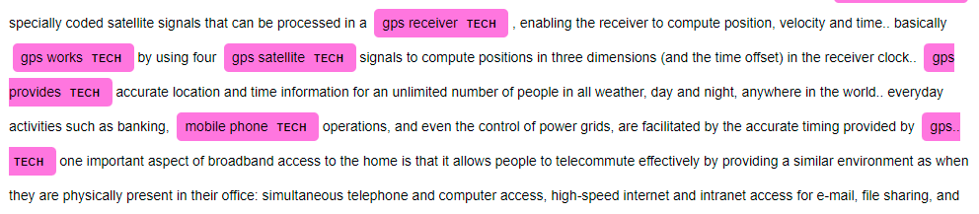
Performance of Spacy NER Model
We have used 21380 records for training
On testing it is predicting NER tags with 94% accuracy
Some Examples, where prediction is not exact
Actual tag is [telephone networks], while predicted tag is [telephone]
Actual tag is [semantic web search engines], while predicted tag is [semantic web]
Actual tag is [distributed memory], while predicted tag is [shared memory]
Actual tag is [programming languages], while predicted tag is [programming systems]
Actual tag is [networked systems], while predicted tag is [distributed networked systems]
Actual tag is [hard disk], while predicted tag is [data protection]
Actual tag is [tag identification], while predicted tag is [Not Detected]

Slide 6
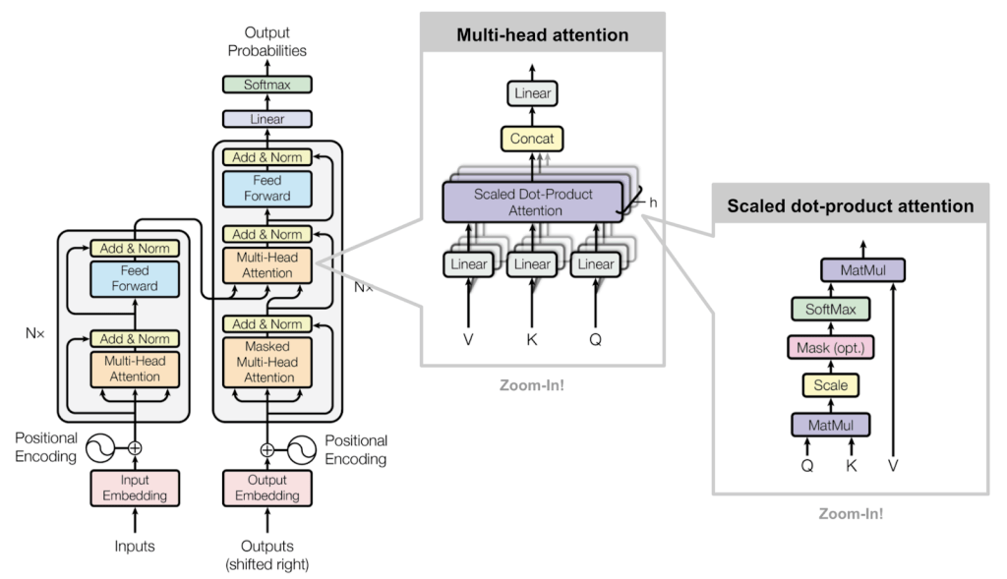
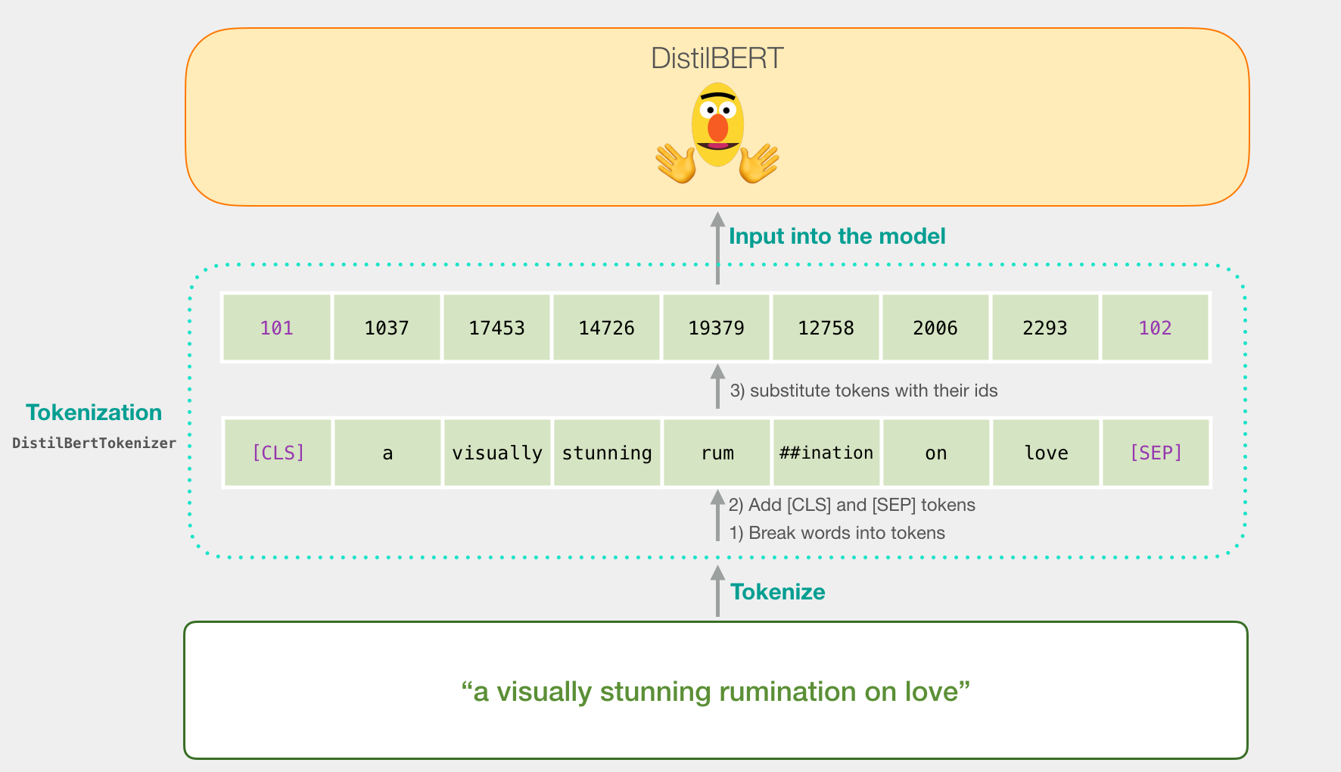
Custom NER model using Transformers (Deep Learning)
BERT stands for Bidirectional Encoder Representations from Transformers. It is a famous transformer in the field of NLP. This transformer is a pre-trained transformer like the others. The training for this transformer is performed by deep bidirectional representation from the unlabeled text by jointly conditioning on both left and right context and using the data from English Wikipedia(2500 M words) and wordsBooksCorpus. (We have used distilbert-base-uncased as base model)

Slide 7

Data Preparation for Transformers NER model
DistilBERT is a transformers model, smaller and faster than BERT, which was pretrained on the same corpus in a self-supervised fashion, using the BERT base model as a teacher. For details check https://huggingface.co/distilbert-base-uncased
Data Should in following format
TERM/ Word
Entity name, TECH in our case

Slide 8
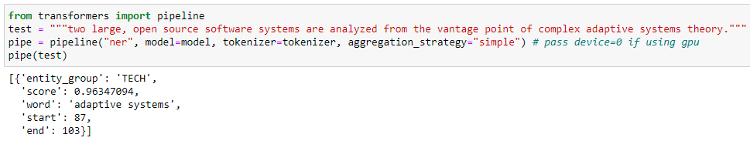
Performance of Transformers NER Model
We have used 21380 records for training
On testing it is predicting NER tags with 84% accuracy
Some Examples, where prediction is not exact
Actual tag is [cognitive networks], while predicted tag is [cognitive]
Actual tag is [energy management system], while predicted tag is [management system]
Actual tag is [proxy server], while predicted tag is [Not Detected]
Actual tag is [3g], while predicted tag is [3]
Actual tag is [wsns], while predicted tag is [w]
Actual tag is [social network analysis], while predicted tag is [social network]
Actual tag is [nano technology], while predicted tag is [nano]

Slide 9
Performance of Transformers NER Model
Spacy is traditional technique (multi-layer CNN), while BERTs are neural network based language models
Spacy is recommended for small datasets, while BERTs are recommended when you have large datasets
In our case, BERT has less accuracy than Spacy, because I have not fine tune the Model (this is just initial model – needs to be tuned before deployment)
We can tune both models for our data

Slide 10
Conclusion
We have successfully trained our own custom models for Named Entity Recognition (NER) using Spacy as well transformers (BERT/ deep learning based model). Spacy performed very well, because we have a small dataset, also BERT is not fully tuned in this case (require extensive resources in term of training time and memory). We can achieve even high performance if we further fine tuned the model.

Slide 11

Last!!!

